Slide 1
Devops – CI/CD Nagios
23-11-2020 to 27-11-2020
Venkatesh Reddy Madduri && ShankarPrasad

Slide 2
Agenda
What is Continuous Monitoring
What is Nagios
Architecture
Configuration
Features
Applications
Hosts and Services
Commands
Checks and States
Ports and Protocols
Add-Ons / Plugins
NRPE
Additional Products
Installation and Demo

Slide 3
What is Continuous Monitoring ?
Continuous monitoring starts when the deployment is done on the production servers. From then on, this stage is responsible to monitor everything happening. This stage is very crucial for the business productivity.
There are several benefits of using Continuous monitoring −
It detects all the server and network problems.
It finds the root cause of the failure.
It helps in reducing the maintenance cost.
It helps in troubleshooting the performance issues.
It helps in updating infrastructure before it gets outdated.
It can fix problems automatically when detected.
It makes sure the servers, services, applications, network is always up and running.
It monitors complete infrastructure every second.

Slide 4
What is Nagios and Why?
Nagios is an open-source continuous monitoring tool which monitors network, applications and servers. It can find and repair problems detected in the infrastructure, and stop future issues before they affect the end users. It gives the complete status of your IT infrastructure and its performance.
Why?
It can monitor Database servers such as SQL Server, Oracle, Mysql, Postgres
It gives application level information (Apache, Postfix, LDAP, Citrix etc.).
Provides active development.
Has excellent support form huge active community.
Nagios runs on any operating system.
It can ping to see if host is reachable.

Slide 5
Architecture
The following points are worth notable about Nagios architecture −
Nagios has server-agent architecture.
Nagios server is installed on the host and plugins are installed on the remote hosts/servers which are to be monitored.
Nagios sends a signal through a process scheduler to run the plugins on the local/remote hosts/servers.
Plugins collect the data (CPU usage, memory usage etc.) and sends it back to the scheduler.
Then the process schedules send the notifications to the admin/s and updates Nagios GUI.

Slide 6
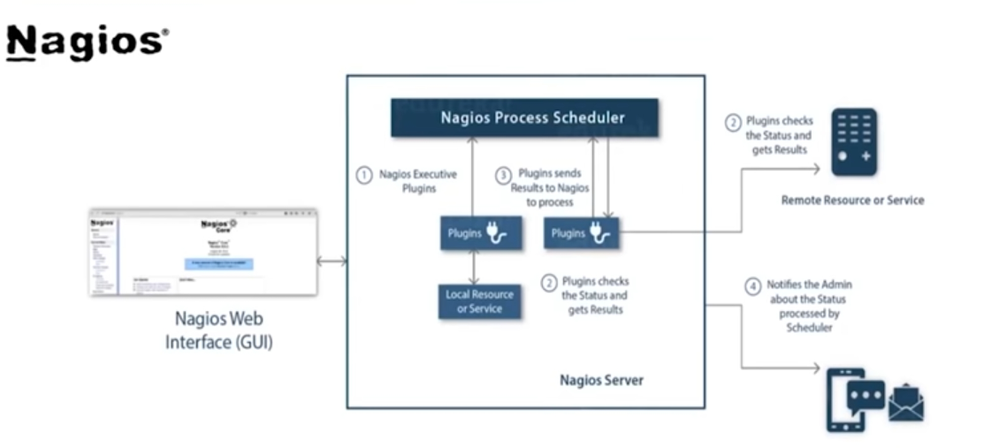
Architecture

Slide 7
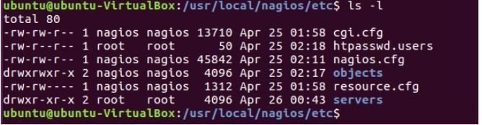
Configuration Files
The configuration files of Nagios are located in /usr/local/nagios/etc. These files are shown in the screenshot given below −
Let us understand the importance of each file now

Slide 8
Configuration Files
nagios.cfg
This is the main configuration file of Nagios core.
File contains the location of log file of Nagios, hosts and services state update interval, lock file and status.dat file.
Nagios users and groups on which the instances are running are defined in this file.
It has path of all the individual object config files like commands, contacts, templates etc.
cgi.cfg [ Common Gateway Interface ]
It tells the CGIs where to find the main configuration file.
The CGIs will read the main and host config files for any other data they might need.
It contains all the user and group information and their rights and permissions.
It also has the path for all frontend files of Nagios.

Slide 9
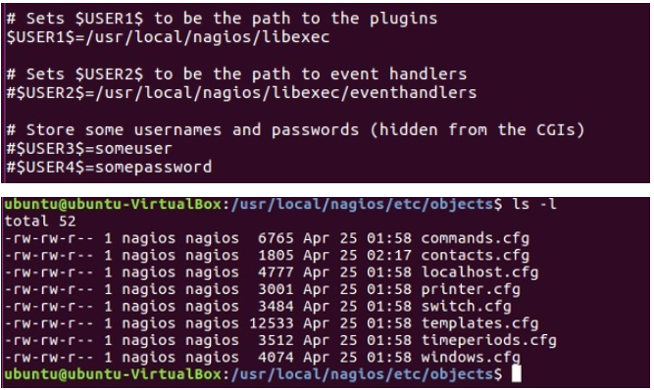
Configuration Files
resource.cfg
We can define $USERx$ macros in this file, which can in turn be used in command definitions in your host config file(s). $USERx$ macros are useful for storing sensitive information such as usernames, passwords, etc.
They are also handy for specifying the path to plugins and event handlers - if you decide to move the plugins or event handlers to a different directory in the future, you can just update one or two $USERx$ macros, instead of modifying a lot of command definitions. Resource files may also be used to store configuration directives for external data sources like MySQL
The configuration files inside objects directory are used to define commands, contacts, hosts, services etc.

Slide 10
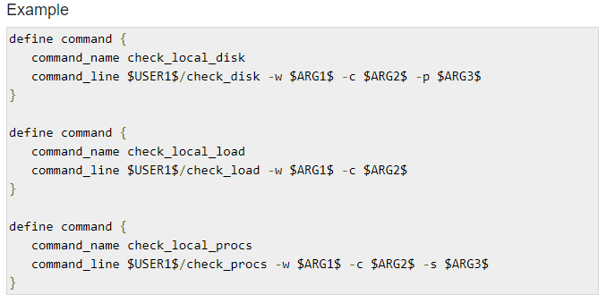
Configuration Files
commands.cfg
This config file provides you with some example command definitions that we can refer in host, service, and contact definitions.
These commands are used to check and monitor hosts and services.
We can run these commands locally on a Linux console where we will also get the output of the command you run.

Slide 11
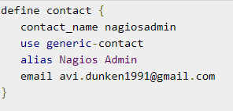
Configuration Files
contacts.cfg
This file contains contacts and groups information of Nagios. By default, one contact is already present Nagios admin.

Slide 12
Features
Nagios Core is open source, hence free to use.
Powerful monitoring engine which can scale and manage 1000s of hosts and servers.
Comprehensive web dashboard giving the visibility of complete network components and monitoring data.
It has multi-tenant capabilities where multiple users have access to Nagios dashboard.
It has extendable architecture which can easily integrate with third-party applications with multiple APIs.
Nagios has a very active and big community with over 1 million + users across the globe.
Fast alerting system, sends alerts to admins immediately after any issue is identified.
Multiple plugins available to support Nagios, custom coded plugins can also be used with Nagios.
It has good log and database system storing everything happening on the network with ease.
Proactive Planning feature helps to know when it’s time to upgrade the infrastructure.

Slide 13
Applications
Monitor host resources such as disk space, system logs etc.
Monitor network resources – http, ftp, smtp, ssh etc.
Monitor log files continuously to identify infra-issue.
Monitor windows/linux/unix/web applications and its state.
Nagios Remote Plugin Executer (NRPE) can monitor services remotely.
Run service checks in parallel.
SSH or SSL tunnels can also be used for remote monitoring.
Send alerts/notifications
via email, sms, pager of any issue on infrastructure
Recommending when to upgrade the IT infrastructure.

Slide 14
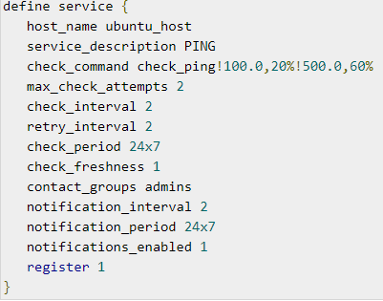
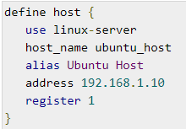
Host and Services
Nagios is the most popular tool which is used to monitor hosts and services running in your IT infrastructure.
Hosts and service configurations are the building blocks of Nagios Core.
Host is just like a computer; it can be a physical device or virtual.
Services are those which are used by Nagios to check something about a host.
We can create a host file inside the server directory of Nagios and mention the host and service definitions.

Slide 15
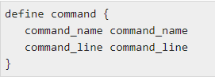
Commands
A command definition defines a command.
Commands include service checks, service notifications, service event handlers, host checks, host notifications, and host event handlers.
Command definitions for Nagios are defined in commands.cfg file.
The following is the format for defining of a Command −
Command name − This directive is used to identify the command. The definitions of contact, host, and service is referenced by command name.
Command line − This directive is used to define what is executed by Nagios when the command is used for service or host checks, notifications, or event handlers.

Slide 16
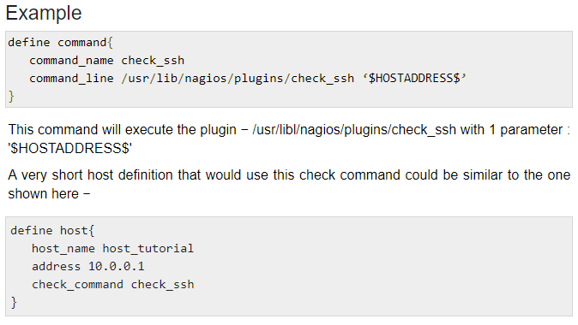
Commands

Slide 17
Commands
We can run external commands in Nagios by adding them to commands file which is processed by Nagios daemon periodically.
With External commands we can achieve lot many checks while Nagios is running. We can temporarily disable few checks, or force some checks to run immediately, disable notifications temporarily etc.
The following is the syntax of external commands in Nagios that must be written in command file −
We can also check out the list of all external commands that can be used in Nagios here https://assets.nagios.com/downloads/nagioscore/docs/externalcmds/

Slide 18
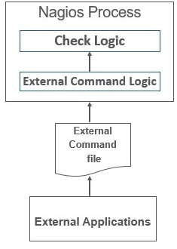
Checks and Status
Passive Checks
Passive checks are performed by external processes and the results are given back to Nagios for processing.
An external application checks the status on hosts/services and writes the result to External Command File. When Nagios daemon reads external command file, it reads and sends all the passive checks in the queue to process them later. Periodically when these checks are processed, notifications or alerts are sent depending on the information in check result.

Slide 19
Checks and Status
Nagios stores the status of the hosts and services it is monitoring to determine if they are working properly or not. There would be many cases when the failures will happen randomly and they are temporary; hence Nagios uses states to check the current status of a host or service.
There are two types of states −
Soft state
Hard state
Soft state
When a host or service is down for a very short duration of time and its status is not known or different from previous one, then soft states are used. The host or the services will be tested again and again till the time the status is permanent.
Hard State
When max_check_attempts is executed and status of the host or service is still not OK, then hard state is used. Nagios executes event handlers to handle hard states.

Slide 20
Protocols and Ports
Protocols
The default protocols used by Nagios are as given under −
http(s), ports 80 and 443 − The product interfaces are web-based in Nagios. Nagios agents can use http to move data.
snmp, ports 161 and 162 − snmp is an important part of network monitoring. Port 161 is used to send requests to nodes and post 162 is used to receive results.
ssh, port 22 − Nagios is built to run natively on CentOS or RHEL Linux. Administrator can login into Nagios through SSH whenever they feel to do so and perform checks.
Ports
The Default ports used by common Nagios Plugins are as given under −
Butcheck_nt (nsclient++) 12489 , NRPE 5666, NSCA 5667, NCPA 5693, MSSQL 1433,MySQL 3306
PostgreSQL 5432,MongoDB 27017, 27018,OracleDB 1521,Email (SMTP) 25, 465, 587,
WMI 135, 445 / additionaldynamically-assigned ports in 1024-1034 range

Slide 21
Protocols and Ports
Protocols
The default protocols used by Nagios are as given under −
http(s), ports 80 and 443 − The product interfaces are web-based in Nagios. Nagios agents can use http to move data.
snmp, ports 161 and 162 − snmp is an important part of network monitoring. Port 161 is used to send requests to nodes and post 162 is used to receive results.
ssh, port 22 − Nagios is built to run natively on CentOS or RHEL Linux. Administrator can login into Nagios through SSH whenever they feel to do so and perform checks.
Ports
The Default ports used by common Nagios Plugins are as given under −
Butcheck_nt (nsclient++) 12489 , NRPE 5666, NSCA 5667, NCPA 5693, MSSQL 1433,MySQL 3306
PostgreSQL 5432,MongoDB 27017, 27018,OracleDB 1521,Email (SMTP) 25, 465, 587,
WMI 135, 445 / additionaldynamically-assigned ports in 1024-1034 range

Slide 22
Add-ons and Plug-ins
Plugins helps to monitor databases, operating systems, applications, network equipment, protocols with Nagios.
Plugins are compiled executables or script (Perl or non-Perl) that extends Nagios functionality to monitor servers and hosts.
Nagios will execute a Plugin to check the status of a service or host.
Nagios can be compiled with support for an embedded Perl interpreter to execute Perl plugins.
Types of Nagios Plugins
Nagios has the following plugins available in it −
Official Nagios Plugins − There are 50 official Nagios Plugins. Official Nagios plugins are developed and maintained by the official Nagios Plugins Team.
Community Plugins − There are over 3,000 third party Nagios plugins that have been developed by hundreds of Nagios community members.
Custom Plugins − We can also write our own Custom Plugins. There are certain guidelines that must be followed to write Custom Plugins.

Slide 23
Add-ons and Plug-ins
Guidelines for Writing Custom Nagios Plugins
While writing custom plugin in Nagios, you need to follow the guidelines given below −
Plugins should provide a "-V" command-line option (verify the configuration changes)
Print only one line of text
Print the diagnostic and only part of the help message
Network plugins use DEFAULT_SOCKET_TIMEOUT to timeout
"-v", or "--verbose“ is related to verbosity level
"-t" or "--timeout" (plugin timeout);
"-w" or "--warning" (warning threshold);
"-c" or "--critical" (critical threshold);
"-H" or "--hostname" (name of the host to check)

Slide 24
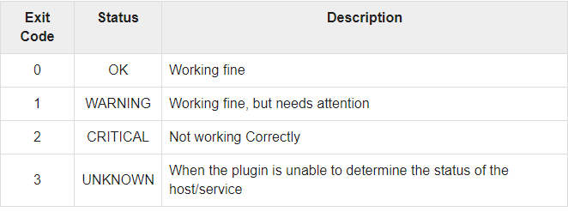
Add-ons and Plug-ins
Guidelines for Writing Custom Nagios Plugins
While writing custom plugin in Nagios, you need to follow the guidelines given below −
Plugins should provide a "-V" command-line option (verify the configuration changes)
Print only one line of text
Print the diagnostic and only part of the help message
Network plugins use DEFAULT_SOCKET_TIMEOUT to timeout
"-v", or "--verbose“ is related to verbosity level
"-t" or "--timeout" (plugin timeout);
"-w" or "--warning" (warning threshold);
"-c" or "--critical" (critical threshold);
"-H" or "--hostname" (name of the host to check)
Multiple Nagios plugin run and perform checks at the same time, for all of them to run smoothly together, Nagios plugin follow a status code. The table given below tells the exit code status and its description −

Slide 25
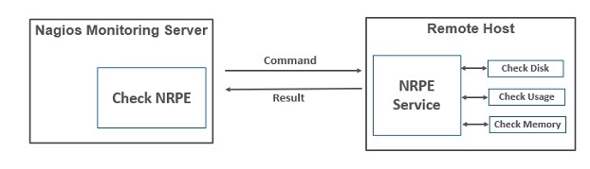
NRPE – Nagios Remote Plugin Executor
The Nagios daemon which run checks on remote machines in NRPE (Nagios Remote Plugin Executor). It allows you to run Nagios plugins on other machines remotely. You can monitor remote machine metrics such as disk usage, CPU load etc. It can also check metrics of remote windows machines through some windows agent addons.

Slide 26
Products
Nagios Core
It is the core on monitoring IT infrastructure. Nagios XI product is also fundamentally based on Nagios core. Whenever there is any issue of failure in the infrastructure, it sends an alert/notification to the admin who can take the action quickly to resolve the issue. This tool is absolutely free.
Nagios XI
It provides monitoring for complete IT infrastructure components like applications, services, network, operating systems etc. It gives a complete view of your infrastructure and business processes. The GUI is easily customizable giving the used flexibility.
The standard edition of this tool costs $1995 and enterprise edition costs $3495.

Slide 27
Products
Nagios Log Server
It makes searching of log data very simple and easy. It keeps all the log data at one location with high availability setup. It can easily send alerts if any issue is found in the log data. It can scale to 1000s of severs giving more power, speed, storage, and reliability to your log analysis platform.
The price of this tool depends on the number of instances - 1 Instance $3995, 2 Instances $4995, 3 Instances $5995, 4 Instances $6995, 10 Instances $14995.
Nagios Fusion
This product provides a centralized view of complete monitoring system. With Nagios Fusion, we can scan setup separate monitoring servers for different geographies. It can be easily integrated with Nagios XI and Nagios core to give the complete visibility of the infrastructure.
This tools costs $2495.

Slide 28
Products
Nagios Network Analyser
It gives the complete information of the network infrastructure to the admin with the potential threats on the network so that admin can take quick actions. It shares very detailed data about the network after in-depth network analysis.
This tools costs $1995.

Slide 29
Installation and Demo
Install Nagios build dependencies
Sudo yum update –y
Sudo yum intall gcc glibc glibc-common gd gd-devel make net-snmp openssl-devel xinetd unzip httpd –y
sudo yum install php php-gd php-common –y
Creating Nagios user and groups
sudo useradd nagios
sudo groupadd nagcmd
sudo usermod -a -G nagcmd nagios

Slide 30
Install Core Nagios
cd ~
curl -L –O https://assets.nagios.com/downloads/nagioscore/releases/nagios-4.1.1.tar.gz
tar xvf nagios-4.1.1.tar.gz
cd nagios-4.1.1
./configure --with-command-group=nagcmd
make all
sudo make install
sudo make install-commandmode
sudo make install-init
sudo make install-config
sudo make install-webconf
sudo usermod -G nagcmd apache

Slide 31
Install NRE
cd ~
curl -L –O http://downloads.sourceforge.net/project/nagios/nrpe-2.x/nrpe-2.15/nrpe-2.15.tar.gz
tar xvf nrpe-2.15.tar.gz
cd nrpe-2.15
./configure --enable-command-args --with-nagios-user=nagios --with-nagios-group=nagios --with-ssl=/usr/bin/openssl --with-ssl-lib=/usr/lib/x86_64-linux-gnu
make all
sudo make install
sudo make install-xinetd
sudo make install-daemon-config
Modify the only_from line by adding the private IP address of your server
sudo vi /etc/xinetd.d/nrpe
only_from = 127.0.0.1 10.132.224.168 [ Save the file and close]
sudo service xinetd restart

Slide 32
Configuring Nagios
uncomment this line #cfg_dir=/usr/local/nagios/etc/servers
sudo vi /usr/local/nagios/etc/nagios.cfg
Make directory
sudo mkdir /usr/local/nagios/etc/servers
Find the email directive, and replace its value with your own email address:
sudo vi /usr/local/nagios/etc/objects/contacts.cfg
email nagios@localhost ; <<***** CHANGE THIS TOYOUR EMAIL ADDRESS ******>>

Slide 33
Configuring check_nrpe Command
sudo vi /usr/local/nagios/etc/objects/commands.cfg
define command{
command_name check_nrpe
command_line $USER1$/check_nrpe -H $HOSTADDRESS$ -c
$ARG1$
}

Slide 34
Configuring Apache
Use htpasswd to create an admin user to access the Nagios web interface:
sudo htpasswd -c /usr/local/nagios/etc/htpasswd.users nagiosadmin
Restart Apache:
sudo systemctl daemon-reload
sudo systemctl start nagios.service
sudo systemctl restart httpd.service
sudo chkconfig nagios on
Now go to the URL
http://server-ip/nagios

Slide 35
Add Hosts
define service {
use generic-service
host_name docker2
service_description PING
check_command check_ping!100.0,20%!500.0,60%
}
define service {
use generic-service
host_name docker2
service_description SSH
check_command check_ssh
notifications_enabled 0
}
mkdir /usr/local/nagios/etc/servers
vim /usr/local/nagios/etc/servers/docker2.cfg
define host {
use linux-server
host_name docker2
alias Docker server
address 192.168.90.62
max_check_attempts 5
check_period 24x7
notification_interval 30
notification_period 24x7
}

Slide 36

Thank you

